Slide 1
Chronic Disease Mortality in the United States
Ruchi Chandrawal, Emily Curlin, Lauren Phelps, Tye Smith, Steve Tuttle, Tyler Williams

Slide 2
Chronic Disease Prevalence and Public Health Impact (CDC)
Chronic Disease: a condition that lasts 1 year or more and requires ongoing medical attention and/or impacts activities of daily living
Examples: heart disease/stroke, cancer, diabetes, obesity, arthritis
Chronic diseases are the leading causes of illness, disability, and death in the United States.
$90% of the nation’s $3.8 trillion per year healthcare costs can be attributed to people with chronic diseases and mental health conditions.
6 in 10 adults in the US have 1 chronic disease, 4 in 10 have two or more.
Treatment of the 7 most common chronic diseases, coupled with productivity losses, will cost the U.S. economy $2 trillion dollars annually - $8,600 per person - by 2030.

Slide 3
The Cause?
Modifiable risk factors:
Tobacco use and exposure to secondhand smoke.
Poor nutrition, including diets low in fruits and vegetables and high in sodium and saturated fats.
Physical inactivity.
Excessive alcohol use
Adequate sleep
Regular screenings
Blood pressure
Cholesterol
Fasting Blood sugar and A1c
Non-modifiable risk factors:
Family history

Slide 4
Diabetes Prevalence and Public Health Impact
Diabetes: impaired glucose metabolism
Prevalence of diabetes continues to rise rapidly (WHO)
1980: 108 million
2014: 422 million
Worldwide, between 2000 and 2019, there was a 3% increase in diabetes mortality rates by age (WHO)
In the US:
11.3% of US population has diabetes
38.0% of US population has prediabetes (CDC)
1 in 4 US adults with diabetes do not know they have it
An estimated 23% of adults are undiagnosed (CDC)
$1 out of every $4 in US health care costs is spent on caring for people with diabetes.

Slide 5
Public Health Burden of Cardiovascular Disease
Diseases of the Heart = CVD
Definition: all types of diseases that affect the heart or blood vessels, including coronary heart disease (clogged arteries), which can cause heart attacks, stroke, heart failure, and peripheral artery disease.
All heart diseases are cardiovascular diseases, but not all cardiovascular diseases are heart disease.
Cardiovascular disease (CVD) remains the leading cause of death in the US, accounted for 928,741 deaths in the year 2020.
CVD accounted for 12% of total US health expenditures in 2018 to 2019- more than any major diagnostic group.

Slide 6
The Data
US Chronic Disease Indicators (CDI) dataset was used to extrapolate the visualizations that follow.
124 indicators were defined to uniformly report and collect chronic disease data across all states and territories
Data was collected by:
Centers for Disease Control and Prevention, National Center for Chronic Disease Prevention and Health Promotion, Division of Population Health
Scope of current analysis:
Mortality from diseases of the heart
Mortality due to diabetes reported as any listed cause of death.

Slide 7
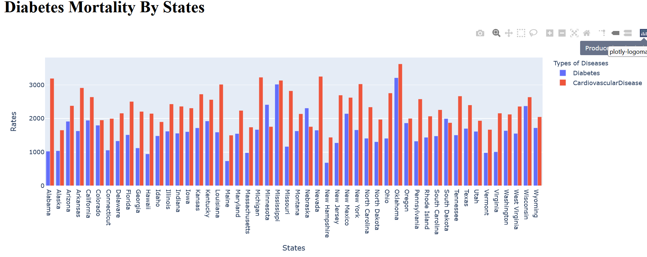
Diseases of the Heart- Plotly
Tye Smith

Slide 8
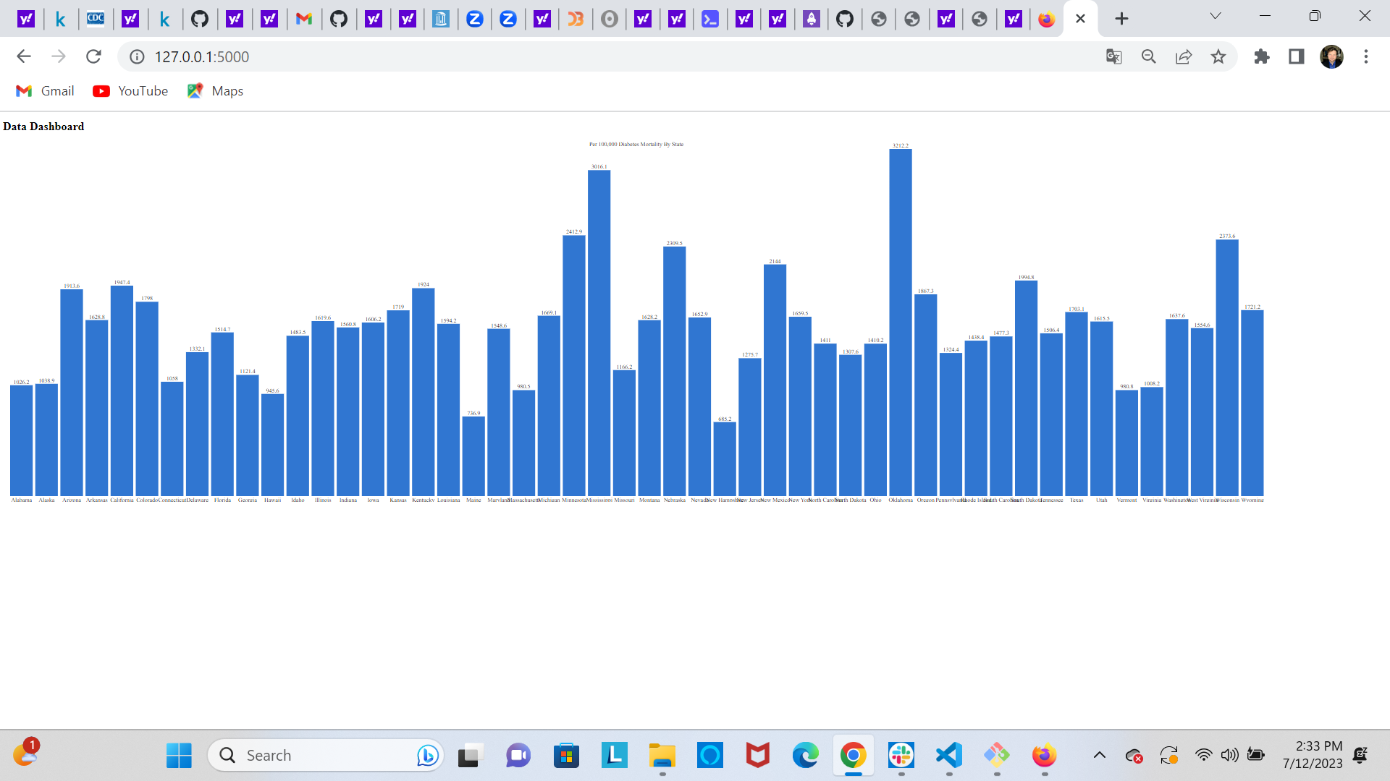
Diabetes Bar Chart-D3
Tye Smith

Slide 9
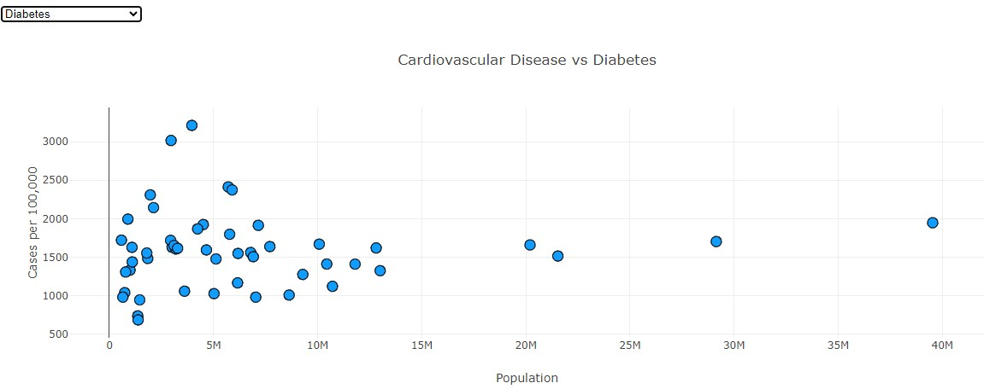
Diabetes Analysis Based on Population

Slide 10
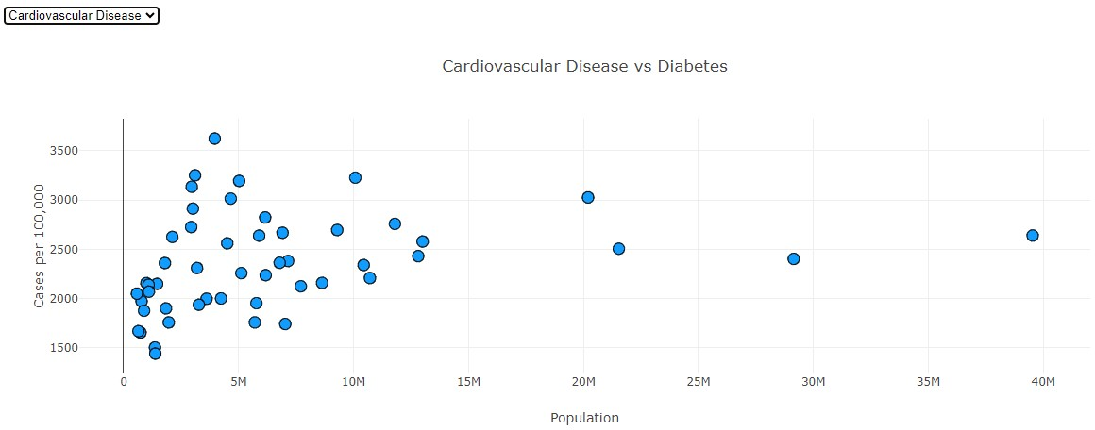
Cardiovascular Disease Analysis Based on Population

Slide 11
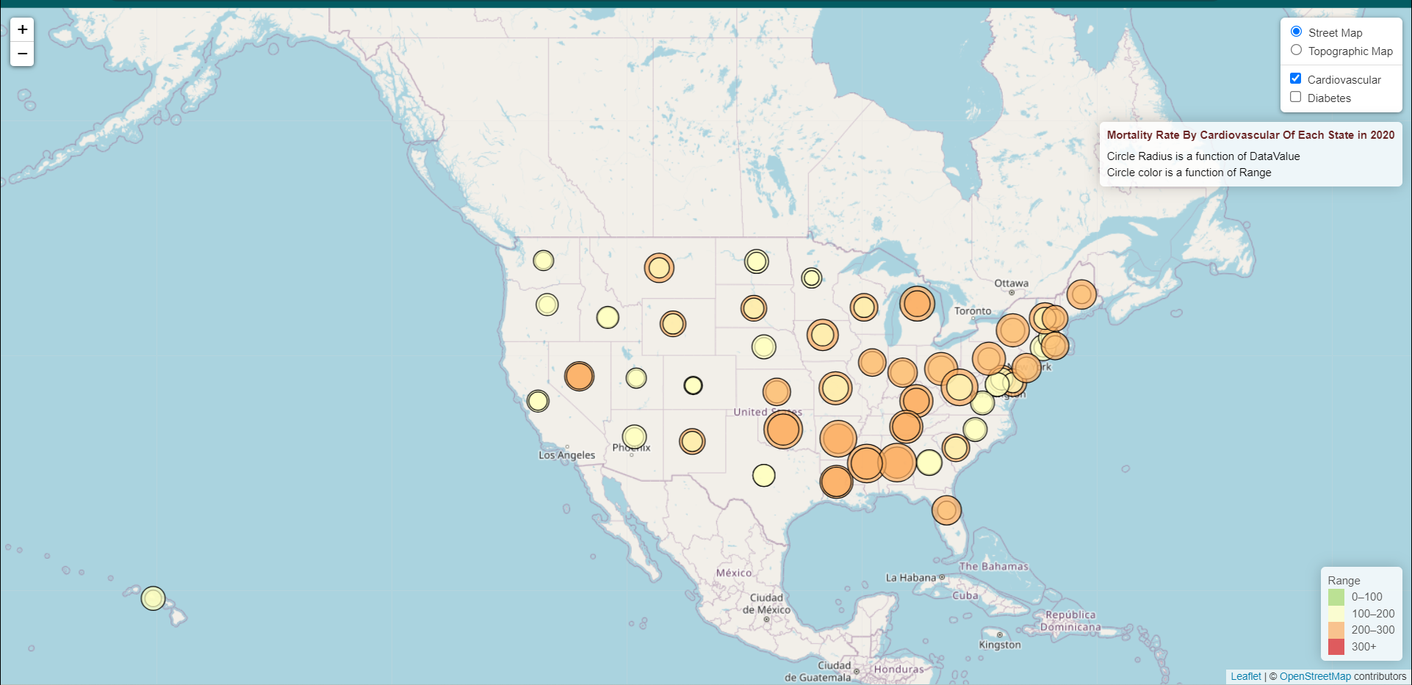
Mortality Rate by Cardiovascular Disease

Slide 12
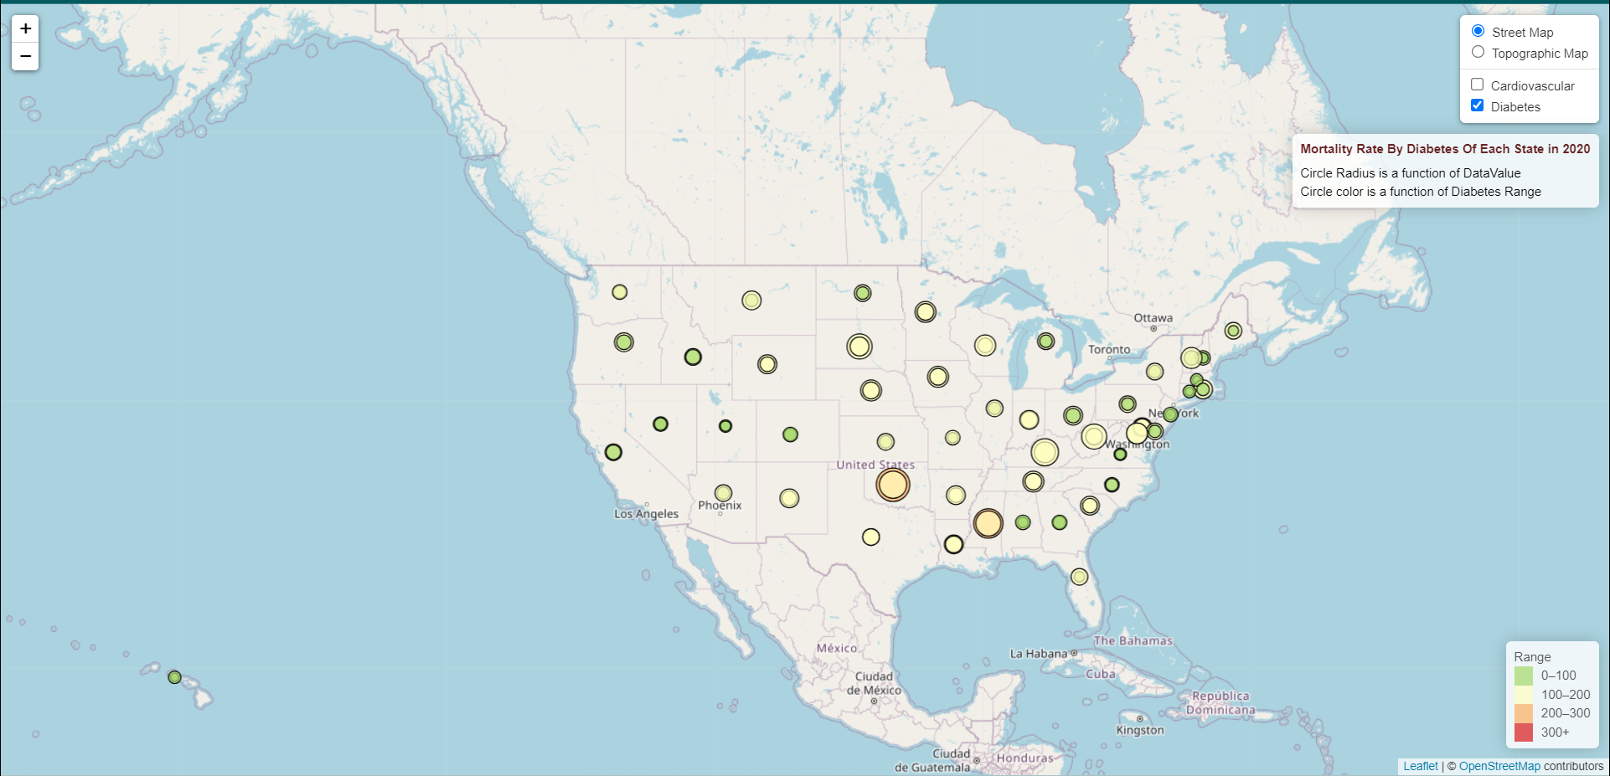
Mortality Rate by Diabetes Disease

Slide 13
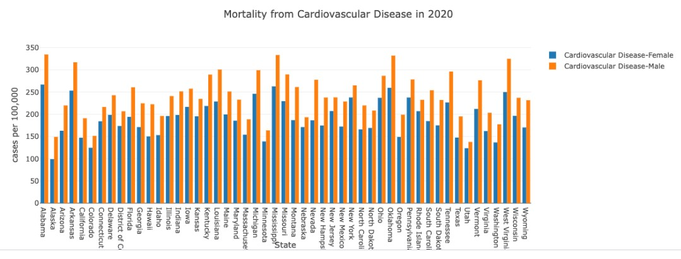
Mortality Rates of Diabetes Based on Gender

Slide 14
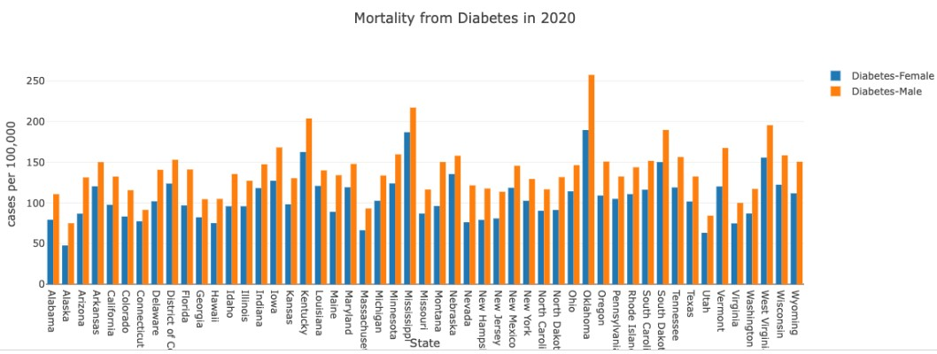
Mortality Rates of Cardiovascular Disease Based on Gender

Slide 15
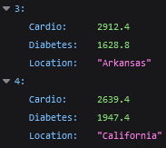

Flask API
API containing the dataset presented in JSON format.
Provides access to data that can be used by graphs, charts, and other visualization.

Slide 16
Opportunities for additional analysis
Are the mortality rates of diabetes confounded by the mortality rates of diabetes?
Did those who die of heart disease also have diabetes?
Adults with diabetes are nearly twice as likely to have heart disease or stroke as adults without diabetes (NIH)
What are the economic implications in states with higher mortality rates related to diabetes/CVD
What specific economic and socioeconomic factors contribute to higher mortality rates?
Does higher disease prevalence directly correlate with mortality

Slide 17
Chronic Disease Prevalence and Public Health Impact (CDC)
Chronic Disease: a condition that lasts 1 year or more and requires ongoing medical attention and/or impacts activities of daily living
Examples: heart disease/stroke, cancer, diabetes, obesity, arthritis
Chronic diseases are the leading causes of illness, disability, and death in the United States.
$90% of the nation’s $3.8 trillion per year healthcare costs can be attributed to people with chronic diseases and mental health conditions.
6 in 10 adults in the US have 1 chronic disease, 4 in 10 have two or more.
Treatment of the 7 most common chronic diseases, coupled with productivity losses, will cost the U.S. economy $2 trillion dollars annually - $8,600 per person - by 2030.

Slide 18
The Cause?
Modifiable risk factors:
Tobacco use and exposure to secondhand smoke.
Poor nutrition, including diets low in fruits and vegetables and high in sodium and saturated fats.
Physical inactivity.
Excessive alcohol use
Adequate sleep
Regular screenings
Blood pressure
Cholesterol
Fasting Blood sugar and A1c
Non-modifiable risk factors:
Family history

Slide 19
Diabetes Prevalence and Public Health Impact
Diabetes: impaired glucose metabolism
Prevalence of diabetes continues to rise rapidly (WHO)
1980: 108 million
2014: 422 million
Worldwide, between 2000 and 2019, there was a 3% increase in diabetes mortality rates by age (WHO)
In the US:
11.3% of US population has diabetes
38.0% of US population has prediabetes (CDC)
1 in 4 US adults with diabetes do not know they have it
An estimated 23% of adults are undiagnosed (CDC)
$1 out of every $4 in US health care costs is spent on caring for people with diabetes.

Slide 20
Public Health Burden of Cardiovascular Disease
Diseases of the Heart = CVD
Definition: all types of diseases that affect the heart or blood vessels, including coronary heart disease (clogged arteries), which can cause heart attacks, stroke, heart failure, and peripheral artery disease.
All heart diseases are cardiovascular diseases, but not all cardiovascular diseases are heart disease.
Cardiovascular disease (CVD) remains the leading cause of death in the US, accounted for 928,741 deaths in the year 2020.
CVD accounted for 12% of total US health expenditures in 2018 to 2019- more than any major diagnostic group.

Slide 21
The Data
US Chronic Disease Indicators (CDI) dataset was used to extrapolate the visualizations that follow.
124 indicators were defined to uniformly report and collect chronic disease data across all states and territories
Data was collected by:
Centers for Disease Control and Prevention, National Center for Chronic Disease Prevention and Health Promotion, Division of Population Health
Scope of current analysis:
Mortality from diseases of the heart
Mortality due to diabetes reported as any listed cause of death.

Slide 22
Diseases of the Heart- Plotly
Tye Smith

Slide 23
Diabetes Bar Chart-D3
Tye Smith

Slide 24
Diabetes Analysis Based on Population

Slide 25
Cardiovascular Disease Analysis Based on Population

Slide 26
Mortality Rate by Cardiovascular Disease

Slide 27
Mortality Rate by Diabetes Disease

Slide 28
Mortality Rates of Diabetes Based on Gender

Slide 29
Mortality Rates of Cardiovascular Disease Based on Gender

Slide 30
Flask API
API containing the dataset presented in JSON format.
Provides access to data that can be used by graphs, charts, and other visualization.

Slide 31
Opportunities for additional analysis
Are the mortality rates of diabetes confounded by the mortality rates of diabetes?
Did those who die of heart disease also have diabetes?
Adults with diabetes are nearly twice as likely to have heart disease or stroke as adults without diabetes (NIH)
What are the economic implications in states with higher mortality rates related to diabetes/CVD?
What specific economic and socioeconomic factors contribute to higher mortality rates?
Does higher disease prevalence directly correlate with mortality?

